Slide 1
21st Century Global communication

Slide 2
Paulding county schools technology mission
The technology mission of the Paulding County School District is to provide the technology infrastructure for every student and teacher to be technology literate and utilize technology as a vital component of the instructional program. It is imperative that education remain relevant to the age in which our students and staff live. The ability to gather, manipulate, and present data using technology as the medium is a required skill in the emerging global community.

Slide 3
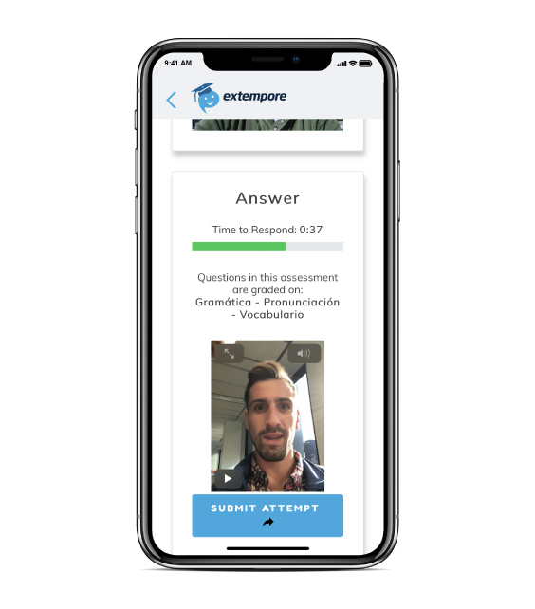
What is extempore?
Extempore puts technology efficiency in the hands of the students and eliminates the need for an expensive language lab for speaking and listening practice. Students work on their computers or mobile devices. (Oral Language Assessment Tools).
This is a research-based Language Acquisition Assisted Technology for students 6th-12th grade.
Talk to your students through video or audio.
Create assessments on the website.
Provide real-time feedback to your students.
Students hear, watch videos, provide written responses, spoken responses and video responses.
Target individual student needs for Differentiation

Slide 4
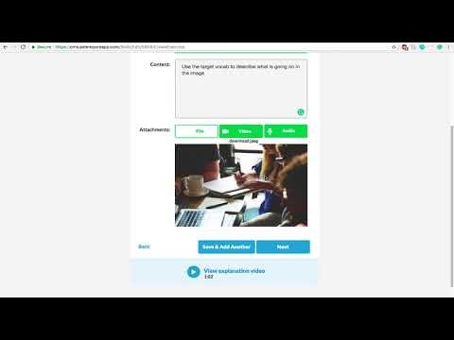
overview

Slide 5
How can extempore support our community?
In the World Language Classroom:
This Assistive Technology allows the students to participate in research-based language acquisition strategies and take charge in their own education. Extempore allows the teacher to take the facilitator role rather than lecturer. Lessons can be built to engage the individual student in tasks that otherwise will not be available to them in the regular classroom setting.
This AT is completely aligned with the World Language standards. The students are required to participate in all forms of communication, from writing and speaking to non-verbal communication through the use of pictures and videos to provide meaning and context.
You can raise the Engaged Learning Indicators and make it more Culturally Responsive by creating your own context.
Parents have the ability to monitor student progress directly form the device they use.
Completely confidential and safe while promoting motor skills, communication skills and reading/writing skills.

Slide 6
How can extempore support our community?
In the Special Needs and ELL Classroom:
This technology is not limited to World Language classrooms. This AT can be used to promote student achievement in the Special Needs and the ELL classrooms. The teacher records video and/or audio for later use while providing one-on-one assistance to the individual needs of the students. English Language Learners have the opportunity to reverse the process by learning the target language and meeting the standards of the course.
Parents have the ability to monitor student progress directly form the device they use.
Completely confidential and safe while promoting motor skills, communication skills and reading/writing skills.

Slide 7
Objectives
Mobile-Assisted Language Learning Proven to increase student achievement by:
Promoting Learner’s Language Development
Oral Proficiency
Reducing Anxiety
The students are more accountable and feel more in charge of their own education
In Kessler’s (2010) study reported less self-consciousness and anxiety when completing the speaking tasks. In addition to reduced speaking anxiety, research also shows that learners, especially younger ones, exhibit positive attitudes towards the use of mobile-assisted language learning tasks (Ally, Tin & Woodburn, 2011).

Slide 8
Objectives cont.
Increase student achievement while meeting the standards in technology from Paulding County Schools as an instructional strategy.
Acquire and monitor student’s progress through the use of data stored directly in the program and App.
Teachers can adapt their lessons to promote higher order of thinking skills for students in any level.
High School students benefit from the freedom to perform the tasks any time of the day.

Slide 9
Integrate Extempore into Canvas
Extempore is an Assistive Technology that is compatible with the technology we use for Digital Learning.
Extempore can be completely integrated to the system. Students can access directly from CANVAS, our platform for Online Learning.
Students can collaborate with their peers while maintaining the integrity needed for maximum achievement.
Teachers can collaborate through the CANVAS platform as we are doing right now!

Slide 10
Differentiation & literacy
Differentiate your lessons by creating a diverse plan. Through audio, you can record for your students reading to them while they read the text simultaneously. Through video, you can perform tasks for your students to model in any final project you may create. Record lectures for later use while freeing class time for discussions, collaboration and creative thinking.
The students can do anything you can do. This allows the students to acquire a professional role, while allowing them to perform the task at their own level. Literacy lessons can become more fun and engaging by having the students take an active role in their learning rather than a passive listener role.

Slide 11
limitations
Students need their own device for home use.
We have experienced some limitations when it comes to home and the availability of technology.
Training is completely online. Some teachers are not extremely comfortable with online tutorials.
License-based purchase. The cost of the license is per student. However, the more you buy the cheaper it gets.
For the free option only 3 assessments allowed.

Slide 12
Cost & training
The cost of the license is based on the amount of students you want to join.
Full access to service $4.75 per student.
Free option per teacher (only 3 assessments)
The training for Professional Development is Online Learning.

Slide 13
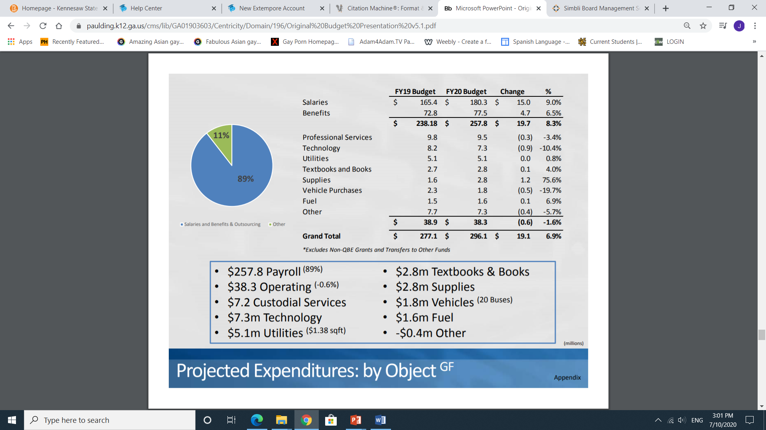
Funding for program
The cost of the license could be included in this year’s 7.3m Technology budget
Apply for Technology Grants
PTA donation to supplement cost

Slide 14
Why acquire this technology?
This AT is research-based technology that is proven to increase student achievement.
It meets the standards of World Language/ELL Special Needs students.
Differentiation and Literacy for other classes.
Compatible with technology already in place (CANVAS).
Student accountability and success.
It is aligned with the Paulding County Schools Technology Mission.

Slide 15
reflection
After learning how Assistive Technology can be a powerful tool in the development of lesson plans, helping students with disabilities, improve test scores and promote critical thinking skills, I decided to take and active role in the implementation of new technology in our classrooms. This technology can be a powerful tool in the development of speech, communication, reading and writing, not only in a World Language class but also the other areas already mentioned before. Evaluating this Emerging Technology has enabled me to be more conscious to the needs not only of my students, but the needs of everyone in our community of students.
Evaluating this technology has given me the knowledge to know what to look for in an AT program in order to maximize instruction and student achievement.

Slide 16
sources
Google Images
Paulding County School District / Homepage. (n.d.). Retrieved July 10, 2020, from https://www.paulding.k12.ga.us/
Paulding County School District / Homepage. (n.d.). Retrieved July 10, 2020, from https://www.paulding.k12.ga.us/cms/lib/GA01903603/Centricity/Domain/207/PCSD_Technology_Plan_2018_fina l.pdf
Oral Language Assessment Tools, Open Free Instructor Account. (2020.). Retrieved July 10, 2020, from https://extemporeapp.com/
Kessler, G. (2010): Fluency and anxiety in self-access speaking tasks: The influence of environment. Computer Assisted Language Learning, 23(4), 361–375.
Ally, M., Tin, T., & Woodburn, T. (2011). Mobile learning: Delivering French using mobile devices. Proceedings 10th World Conference on Mobile and Contextual Learning (mLearn) (p. 448). Beijing, China: Beijing Normal University.

