Slide 1
Copyright and Movies (DVD)
Juan Batista ITEC 7445

Slide 2
What is Copyright?
copyright is a form of legal protection given to content creators through the assignment of specific rights to works that qualify for protection.(copyright.com)

Slide 3
Copyright and Movies (DVD)
Section 110(1) of Title 17 of the United States Code grants a specific exemption from the copyright laws for: performance or display of a work by instructors or pupils in the course of face-to-face teaching activities of a nonprofit educational institution, in a classroom or similar place devoted to instruction, unless, in the case of a motion picture or other audiovisual work, the performance, or the display of individual images, is given by means of a copy that was not lawfully made under this title, and that the person responsible for the performance knew or had reason to believe was not lawfully made .... (Foley Library, Gonzaga University)

Slide 4
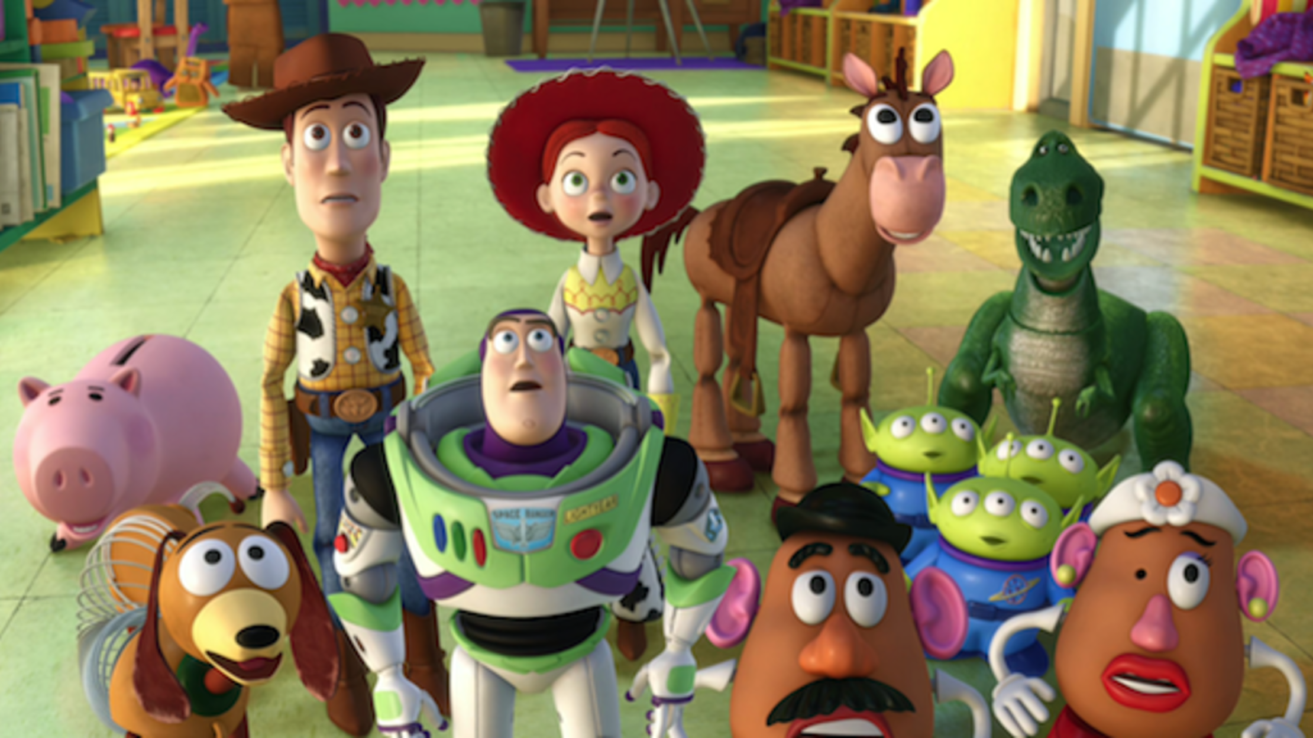
Fair Use and You
Copyrighted material may be used without permission
Teachers and Students are more protected but not immune
Not everything can be claimed in the classroom for “fair use”
However, many things can be claimed for instructional use.

Slide 5
Fair Use is Based in…
The Purpose of the Use
The Nature of the Use
The Amount of Work Used
The Marked Effect of the Use (J.Hansen)
**no one factor overrides another**

Slide 6
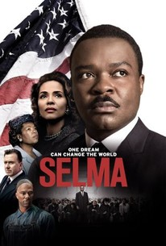
What do I Know?
Mr. Smith just bought the movie “Selma”, saw it at home and loved it. He wants to share this experience with his students and the next day, Friday, he brings the movie in because they have been studying the life of Martin Luther King, jr. and he wants to reward them for their nice work on the projects the did.
Is he in the clear to do this?

Slide 7
What do I Know?
Mr. Smith is not using the movie as an instructional tool, therefore even though he owns the movie, he cannot just show the movie for leisure purposes.

Slide 8
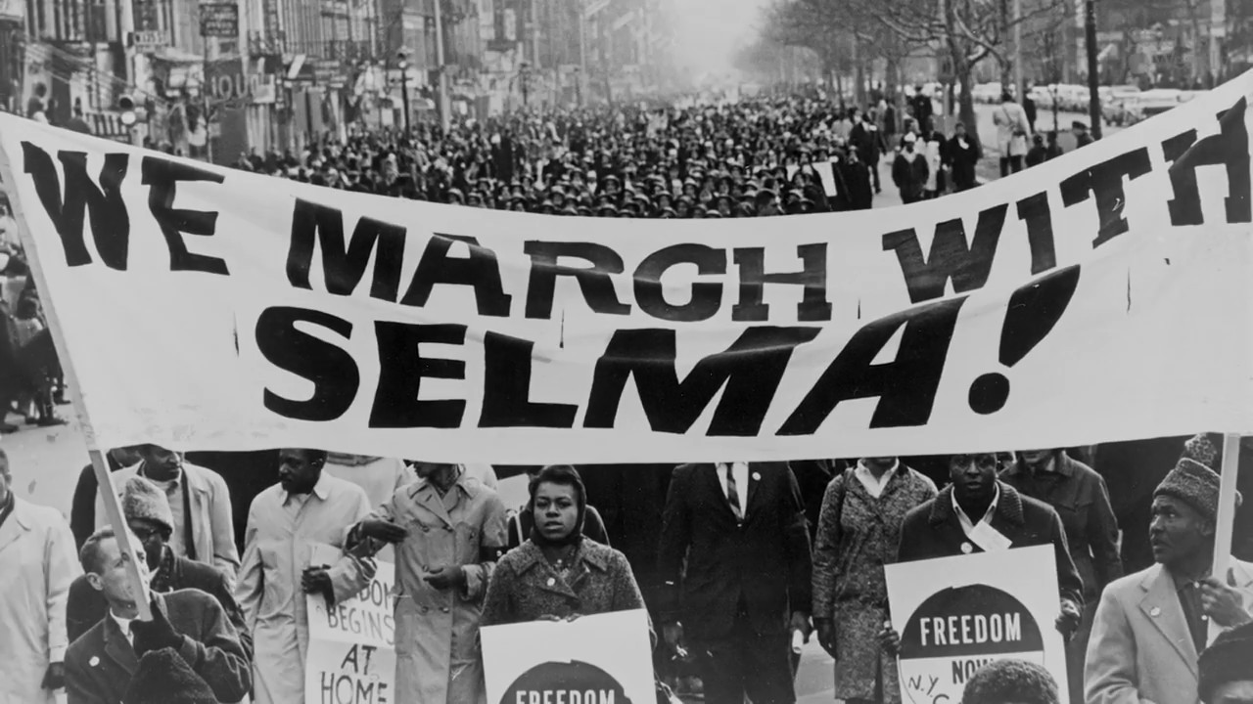
What do I Know?
Mr. Smith just bought the movie “Selma”, saw it at home and loved it. He creates a lesson based on his Social Studies class standards, he shows the whole movie, stopping it at times to explain the historical relevance of the movie, and at the end there is a formative assessment for the students to complete at the end of the movie.
Is he in the clear to do this?

Slide 9
What do I Know?
According to the TEACH Act, teachers that have a legitimate title movie, not copied or re-recorded may use it for instructional purposes in the classroom, in good faith, and you are using it to enhance the learning experience.

Slide 10
Here’s another one
Mr. Smith just finished his lesson on the Civil Rights and he wants to take his class to the museum but does not have the funds. He remembers he bought the movie “Selma” and wants to use it as a fundraiser for his class. He sets up a Movie Time during his planning and charges $3 per student to see it, but the students must write a paper about it for him after they see it.
Is he in the clear to do this?

Slide 11
And the answer is…
Even though he owns the movie, Mr. Smith cannot profit from the use and images of the movie. This is a clear violation of the Copyright for the movie.

Slide 12
Sources
https://whatiscopyright.org/the-story-of-the-copyright-symbol/
Google images
https://guides.lib.utexas.edu/copyright/teachact
https://researchguides.gonzaga.edu/c.php?g=206685&p=1363577
https://www.softchalkcloud.com/lesson/files/gHvO3j6PVUCbDR/CopyrightByJonHansen_KSU.pdf
http://www.copyright.com/learn/about-copyright/

